Slide 1
Stress Detection
in a Persian Pregnancy Forum
Late fusion of structured and ParsBERT signals for human-in-the-loop risk monitoring
Final model
Hybrid CatBoost late fusion
Applied data science | Sharif University of Technology
By : Mohammadreza Darvish , Yazdan Rezvani and Ali Esfahani
Notes:
0:00–0:20. Open with one sentence: We built an end-to-end Persian stress-monitoring pipeline for Ninisite posts, then combined a structured model and a ParsBERT model with late fusion. Emphasize that the operational framing is human-in-the-loop risk monitoring, not autonomous diagnosis.

Slide 2
STRUCTURE
2 / 11
Roadmap
A 10-minute story: from messy forum data to a locked-test fusion result
1
2
3
4
5
Problem &
motivation
Data &
labels
Modeling
approach
Results &
insights
Conclusion &
future work
We spend most of the time on the approach and locked-test results; EDA and implementation details are kept compact.
Notes:
0:20–0:40. Quickly orient the audience. Say there are five beats: why the problem matters, how the labels and leakage-safe data were built, the three-member modeling design, locked-test behavior, and responsible use/future work.

Slide 3
WHY THIS PROJECT
3 / 11
Problem, importance, and prior work
The problem
Why it matters
Prior work
Predict a continuous stress score from Persian forum posts.
Pregnancy forums contain emotional, social, and health-related stress signals.
Social-media mental-health signals have been modeled from language and behavior [1,2].
Convert scores into Low / Moderate / High / Very High stress classes.
Earlier surfacing can help moderators or qualified reviewers prioritize support.
Pregnancy/postpartum social-media behavior has also been studied [1].
Work with noisy, informal, imbalanced user-generated text.
The useful product is longitudinal monitoring—not a one-post diagnosis.
Persian NLP has fewer domain-specific resources; ParsBERT provides a strong monolingual base [3].
Project goal: build a privacy-conscious human-review prioritization overlay—not an autonomous diagnostic or emergency-decision system.
[1] De Choudhury et al., CHI 2013 • [2] Coppersmith et al., CLPsych 2014 • [3] Farahani et al., ParsBERT 2020
Notes:
0:40–1:50. Define the prediction task first. Then motivate the forum context without overstating medical claims. Prior work: De Choudhury et al. showed postpartum behavioral changes can be modeled from social media; Coppersmith et al. quantified mental-health signals in social text; ParsBERT provides the Persian transformer backbone. Close by stating our contribution: an end-to-end Persian pipeline plus late fusion and a human-review operational design.

Slide 4
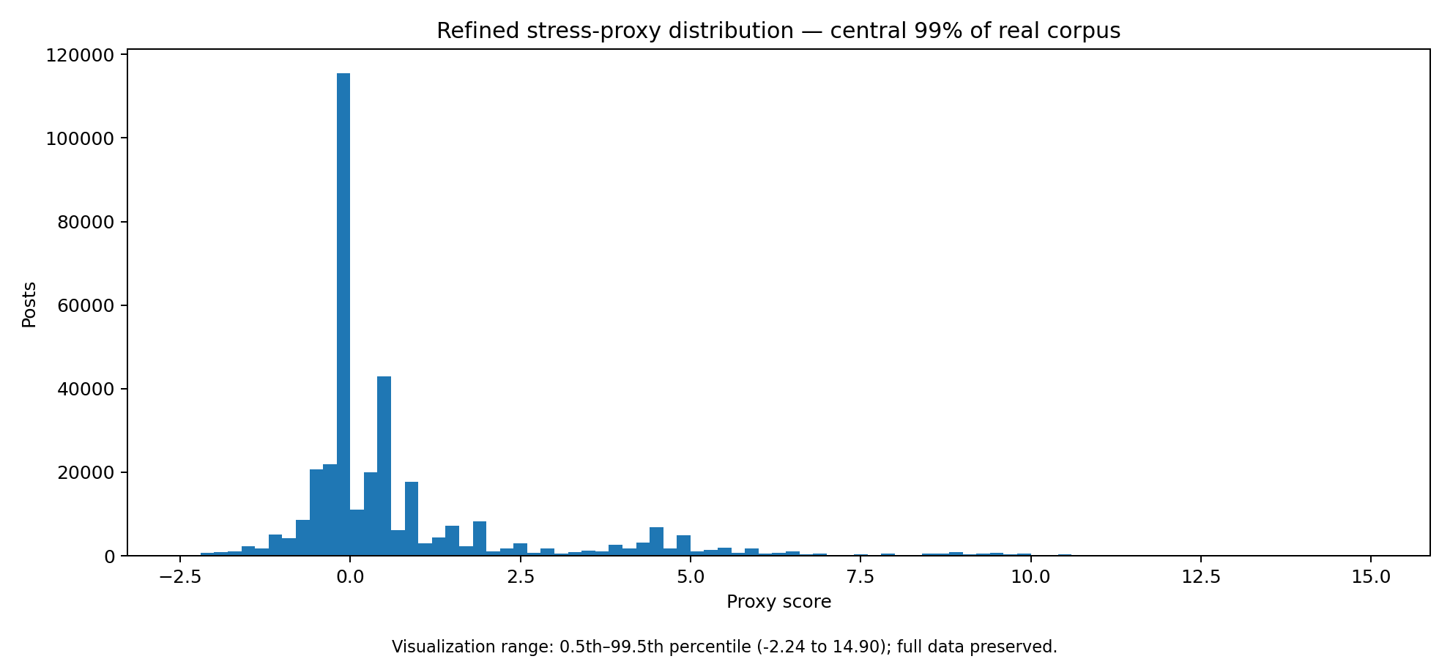
DATA & LABELS
4 / 11
From raw forum posts to a leakage-safe labeled set
1
Scrape & checkpoint
Ninisite threads, posts, profiles
2
Clean & recover
content, category, gender, profile metadata
3
Engineer proxy
lexical / emoji / punctuation stress signals
4
Annotate & expand
dual-LLM annotation + active-learning additions
The stress proxy guided candidate sampling; it was not the final stress target and is not used as a shortcut label at deployment.
5
Freeze roles
grouped train / validation / locked test / embargo
362,017
5,615
4,226
452
453
484
cleaned posts
final matched labels
train
validation
locked test
embargo
Notes:
1:50–3:05. Explain the data journey as a reproducibility story: scrape with checkpoints and retries; clean/recover metadata; build a heuristic proxy for sampling; annotate with ChatGPT Plus and Claude, then add active-learning examples; finally freeze grouped roles. Stress that the labeled distribution is deliberately enriched and must not be interpreted as natural prevalence. Mention the locked test was not reused for tuning.

Slide 5
APPROACH
5 / 11
Three-member modeling strategy
Complementary views of the same post are learned separately, then combined late.
Member 1 • structured
Member 2 • text only
Member 3 • late fusion
CatBoost regression
ParsBERT regression
hybrid_catboost_rmse_depth3
Metadata + behavioral + lexical features
Raw Persian content only
Member 1 prediction + Member 2 prediction
5 grouped folds → OOF train predictions
Same grouped-fold discipline
Base mean / difference / |difference|
Fold ensemble for validation / test
Scalar stress prediction for fusion
Plus engineered tabular signals
Ground-truth stress classes use 3 / 5 / 7. Prediction thresholds were calibrated on validation only: 3.10 / 4.91 / 6.46.
Leakage control: OOF train predictions + grouped folds; the locked test was opened once and is never reused for tuning.
Notes:
3:05–4:25. This is the core algorithm slide. Member 1 learns structured features with CatBoost. Member 2 fine-tunes ParsBERT on text only. Member 3 performs late fusion—not embedding concatenation in the final system. The fusion model receives both scalar base predictions, their mean and disagreement features, plus the engineered tabular features. Emphasize OOF predictions for training and ensemble predictions for validation/test to avoid leakage. Distinguish true class boundaries 3/5/7 from calibrated prediction cutoffs 3.10/4.91/6.46.

Slide 6
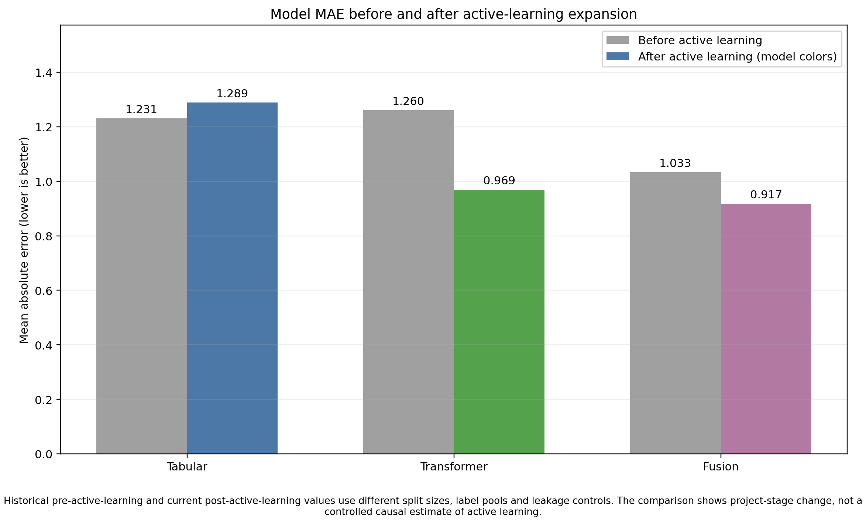
LEARNING LOOP
6 / 11
Active learning expanded the useful label space
Active-learning loop
1
Train initial M1 + M2 + fusion
2
Score the large unlabeled pool
3
Select difficult / high-signal candidates
4
Dual-annotate, merge, retrain
What changed: the transformer and fusion benefited substantially; the tabular model did not improve uniformly. This is why we report the comparison as project-stage evidence, not a causal claim.
Notes:
4:25–5:25. Explain why active learning was used: only a tiny fraction of the ~362k posts could be labeled. We scored the large pool, targeted informative and high-signal cases, dual-annotated them, and retrained. Point out the honest caveat in the figure: before/after stages differ in split size and leakage controls, so this is not a causal experiment. Also note that the tabular model slightly worsened while text and fusion improved—active learning did not help every component equally.

Slide 7
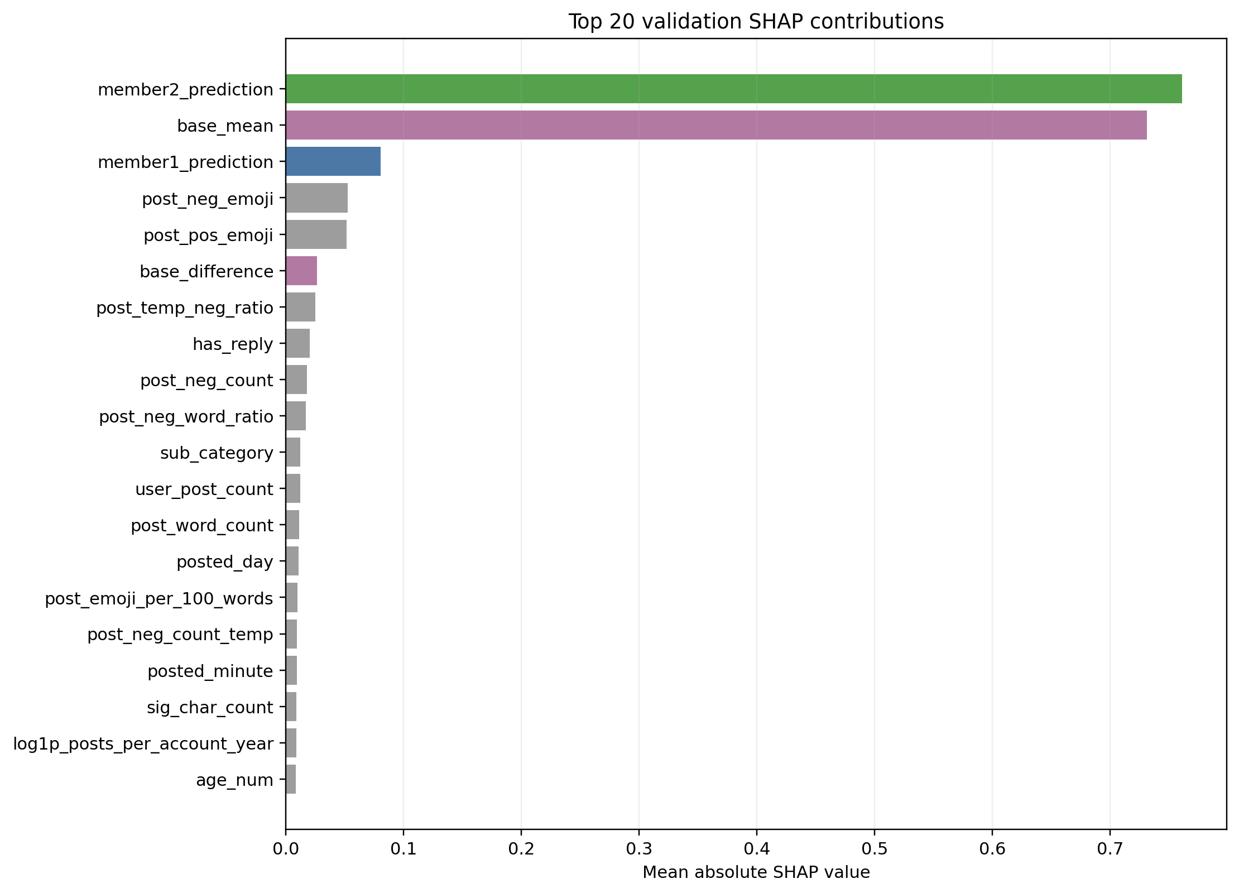
EXPLAINABILITY
7 / 11
What drives the final fusion prediction?
1 Member 2’s text prediction is the strongest single signal.
2 The fusion also uses base-model agreement/disagreement and lexical emotion signals.
3 SHAP is post-training explanation—not feature selection or causal interpretation.
Interpretation: text carries the strongest signal, but structured features add complementary evidence and help the fusion model resolve some cases.
Notes:
5:25–6:10. Keep this slide short. The biggest SHAP contribution is Member 2’s prediction, followed by the base mean and Member 1 prediction. But the model also uses negative/positive emoji, negative-word ratios, reply behavior, sub-category, posting history, and other structured signals. Clarify that SHAP explains the trained model; it does not prove causality and it was not used as an unvalidated feature-selection shortcut.

Slide 8
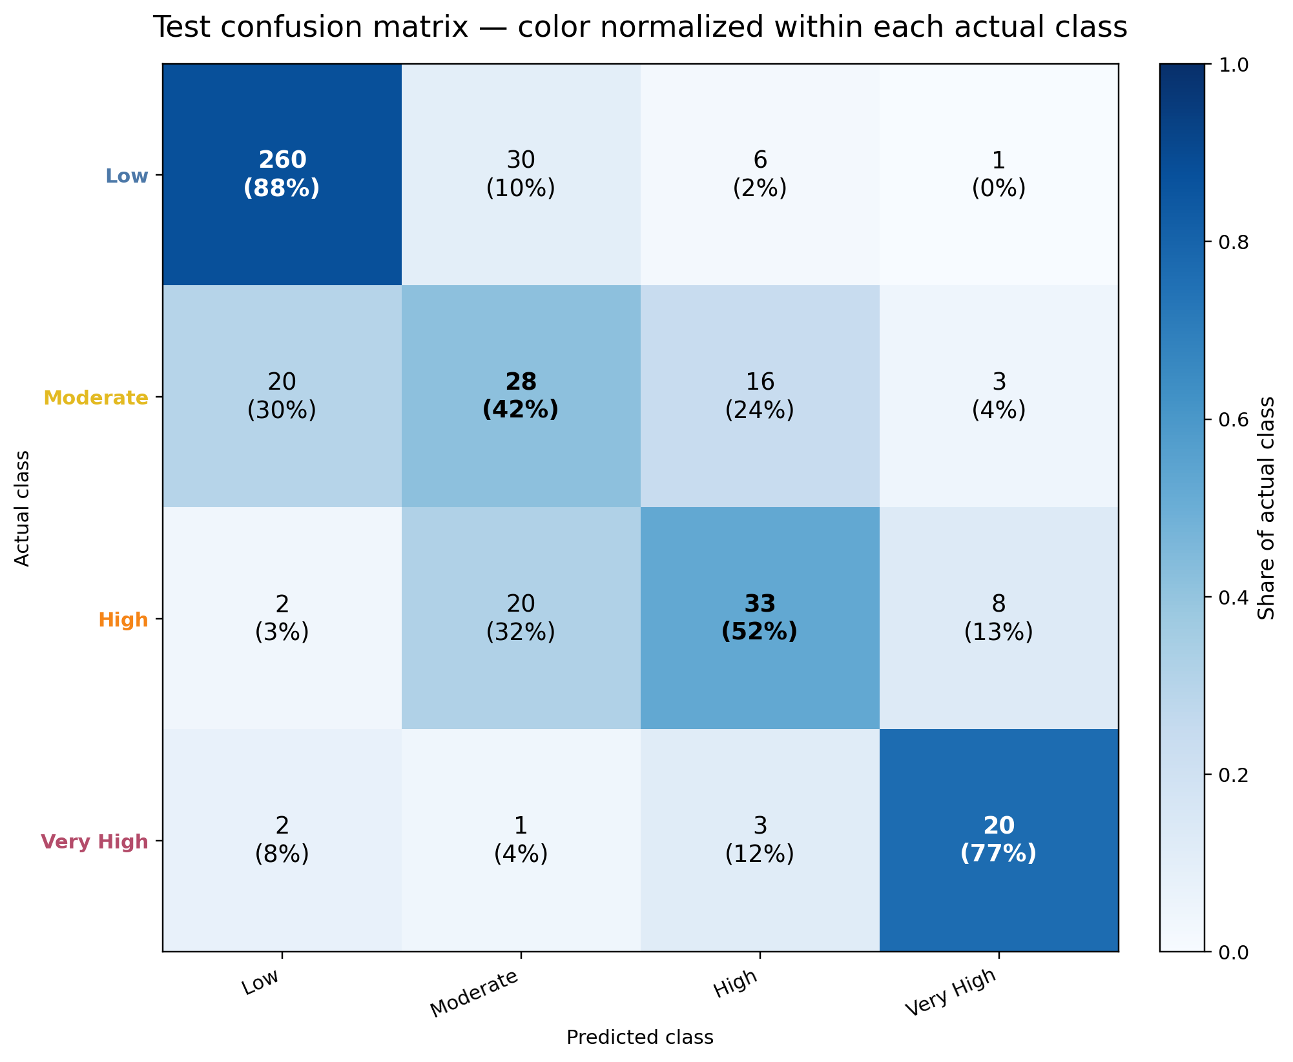
RESULTS
8 / 11
Locked-test performance
Test MAE
0.917
Accuracy
75.3%
Macro F1
0.628
Test n
453
Internal recall objectives
Class | Recall | Target | Status
Low | 87.5% | ≥ 75% | PASS
Moderate | 41.8% | ≥ 50% | MISS
High | 52.4% | ≥ 50% | PASS
Very High | 76.9% | ≥ 75% | PASS
3 of 4 internal recall targets were met. Moderate is the main improvement area; Very High recall met the primary project objective.
Notes:
6:10–7:40. This is the main results slide. Start with continuous error: MAE 0.917 on the locked 453-post test. Then move to the four-class matrix. Low recall is 87.5%, High 52.4%, Very High 76.9%. Moderate is 41.8% and misses its 50% internal target. State the project status precisely: 3 of 4 internal recall targets met. The Moderate errors go both downward and upward, so this is a boundary-overlap problem, not one simple threshold mistake.

Slide 9
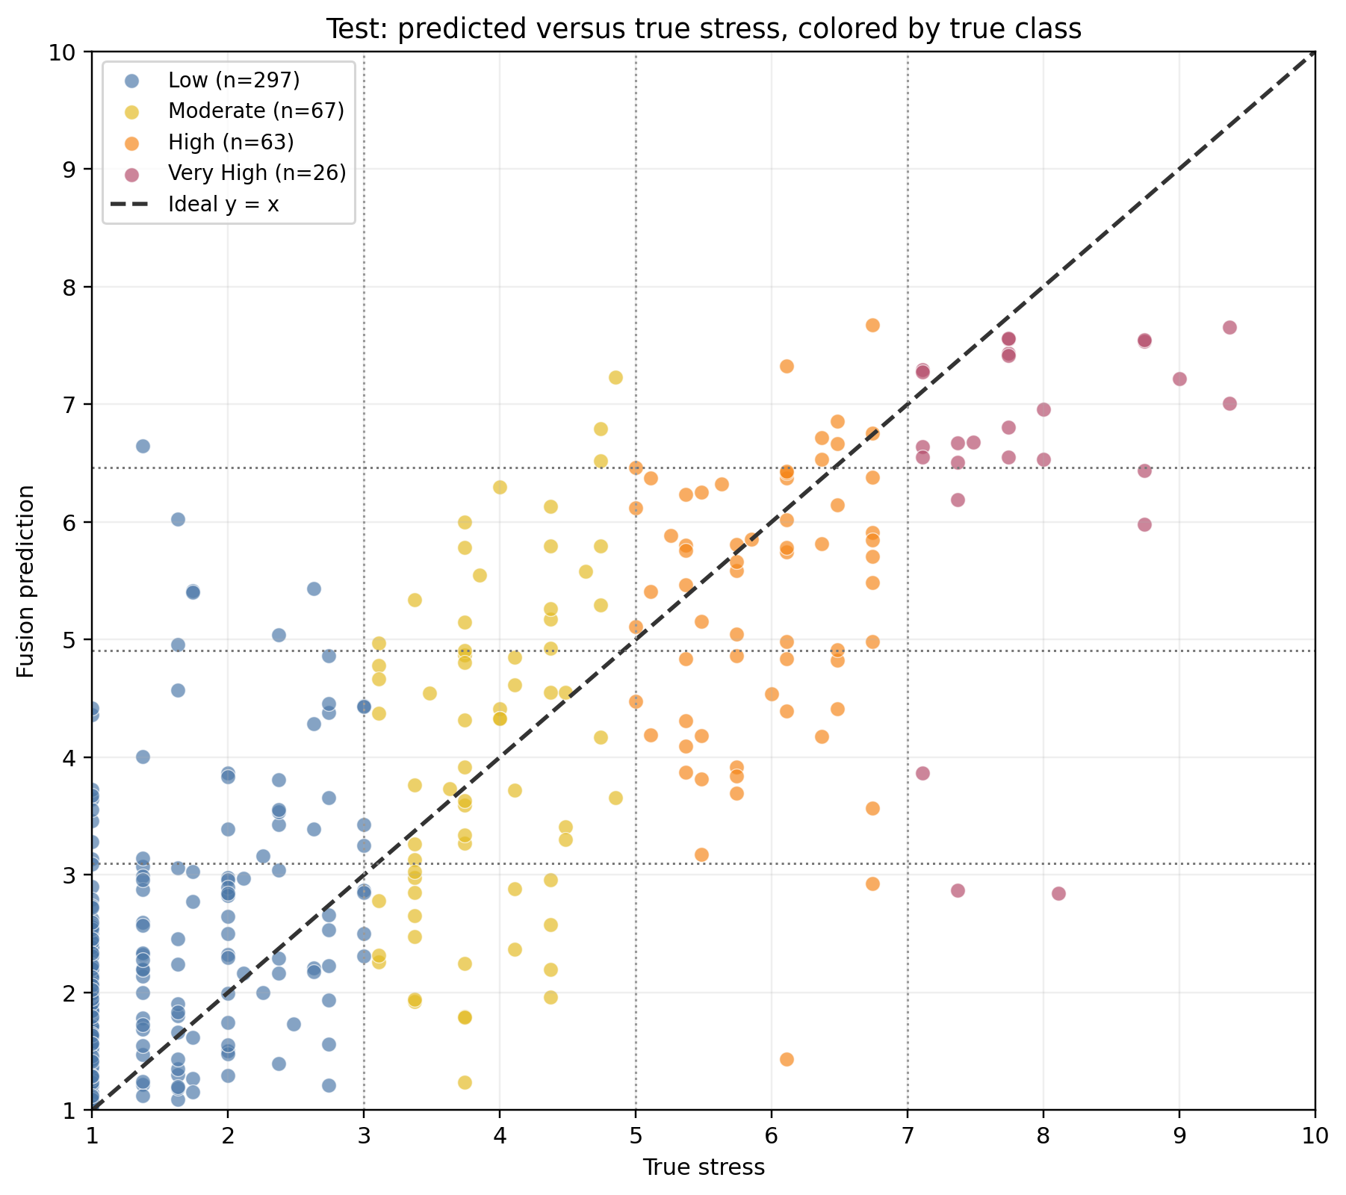
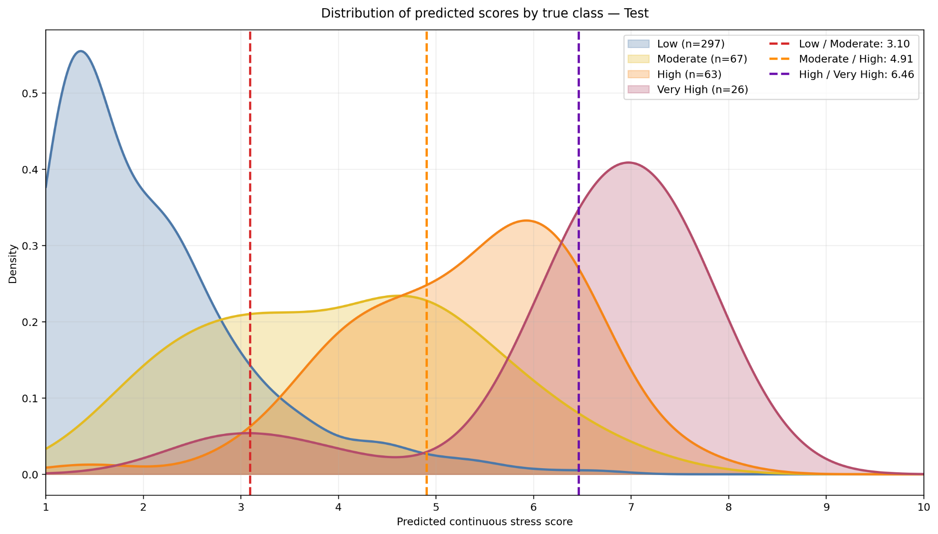
RESULTS
9 / 11
How the fusion score behaves
True-label bins
3 / 5 / 7
Calibrated prediction thresholds
3.10 / 4.91 / 6.46
Takeaway
Low and Very High separate better; Moderate overlaps both neighboring classes.
Notes:
7:40–8:45. Use the scatter to show that predictions rise with true stress, but are shrunk toward the middle—especially at the extremes. Then use the density plot to show why thresholds matter: the Low and Very High distributions are comparatively separated, while Moderate overlaps Low and High. Distinguish the label definitions at 3/5/7 from the calibrated prediction cutoffs 3.10/4.91/6.46.

Slide 10
TAKEAWAYS
10 / 11
Conclusion
What we achieved
Main limitation
End-to-end Persian pipeline: scraping → labels → two base models → fusion
Moderate recall is 41.8% and misses the 50% internal target
Locked-test MAE 0.917 and 3 / 4 internal recall targets met
Errors occur toward both Low and High, indicating class overlap
Very High recall 76.9% for prioritizing severe signals
The enriched label set cannot estimate natural alert prevalence
Notes:
8:45–9:45. Summarize three things: we built the full end-to-end pipeline, the final locked-test result is strong on Low/High/Very High but not Moderate, and the realistic deployment is a private human-review prioritization overlay. Future work should target new annotations around both Moderate boundaries, reserve a fresh untouched confirmation set, and measure real alert burden with offline replay before a limited monitored pilot. Finish before 10:00 and invite questions.

Slide 11

TAKEAWAYS
11 / 11
future work
Next evidence
New dual annotations near both Moderate boundaries
Fresh untouched confirmation set after future tuning
Offline replay + limited monitored pilot with privacy and audit controls
Operational framing
New posts
Post-level score
User-level trend / max
Private review queue
Human decision
Candidate for a human-in-the-loop risk-monitoring overlay. Not an autonomous diagnostic system and not an independent emergency-decision tool.
Notes:
8:45–9:45. Summarize three things: we built the full end-to-end pipeline, the final locked-test result is strong on Low/High/Very High but not Moderate, and the realistic deployment is a private human-review prioritization overlay. Future work should target new annotations around both Moderate boundaries, reserve a fresh untouched confirmation set, and measure real alert burden with offline replay before a limited monitored pilot. Finish before 10:00 and invite questions.

Slide 12
APPENDIX
APPENDIX
References
1. De Choudhury, M., Counts, S., & Horvitz, E. (2013). Predicting postpartum changes in emotion and behavior via social media. CHI 2013. DOI: 10.1145/2470654.2466447.
2. Coppersmith, G., Dredze, M., & Harman, C. (2014). Quantifying Mental Health Signals in Twitter. CLPsych / ACL, pp. 51–60. DOI: 10.3115/v1/W14-3207.
3. Farahani, M., Gharachorloo, M., Farahani, M., & Manthouri, M. (2020). ParsBERT: Transformer-based Model for Persian Language Understanding. arXiv:2005.12515.
4. Khashabi, D. et al. (2020). ParsiNLU: A Suite of Language Understanding Challenges for Persian. arXiv:2012.06154.
5. Ninisite.com — source forum used for project data collection.
All charts shown in the presentation are exact team-generated project output PNG files. No external images were reconstructed or substituted.
Internal artifacts used for metrics and architecture: corrected fusion bundle / project status JSON, split manifest, and final report figures. • AI assistance: ChatGPT (OpenAI).
Notes:
Appendix / backup. Do not present unless asked. This slide satisfies the reference requirement and makes clear that the project figures are the team’s own exact exports.

